Slide 1

Flare

Slide 2
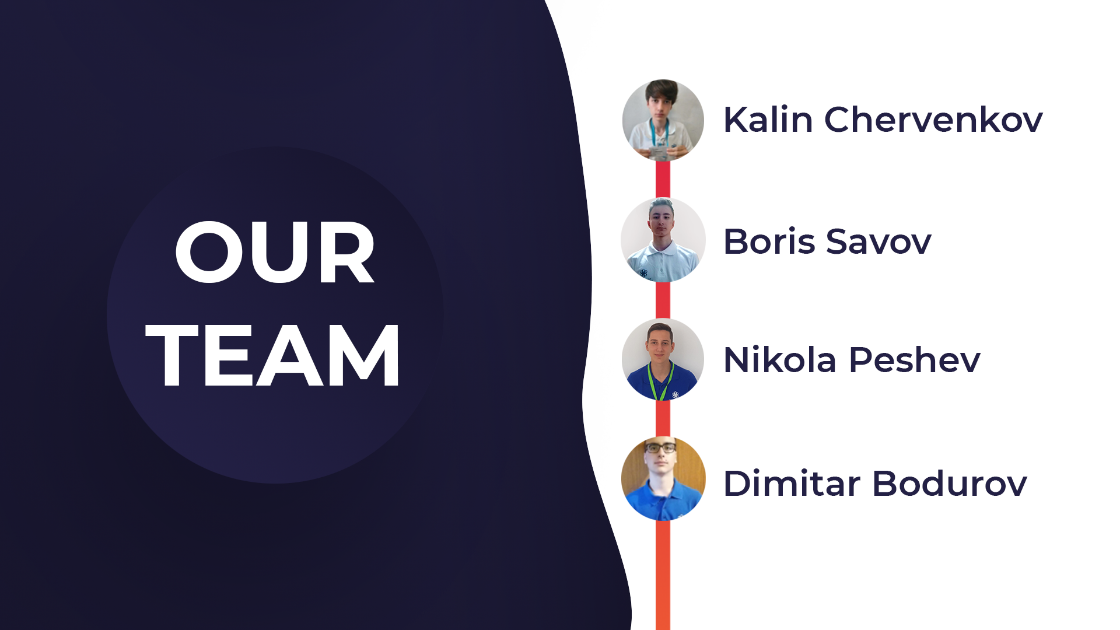
Our team
1.1 Kalin Chervenkov
Frontend Developer
KSChervenkov19@codingburgas.bg
1.2 Nikola Peshev
Backend Developer
NDPeshev19@codingburgas.bg
1.3 Boris Savov
Designer
BNSavov19@codingburgas.bg
1.4 Dimitar Bodurov
Scrum Trainer
DTBodurov19@codingburgas.bg

Slide 3
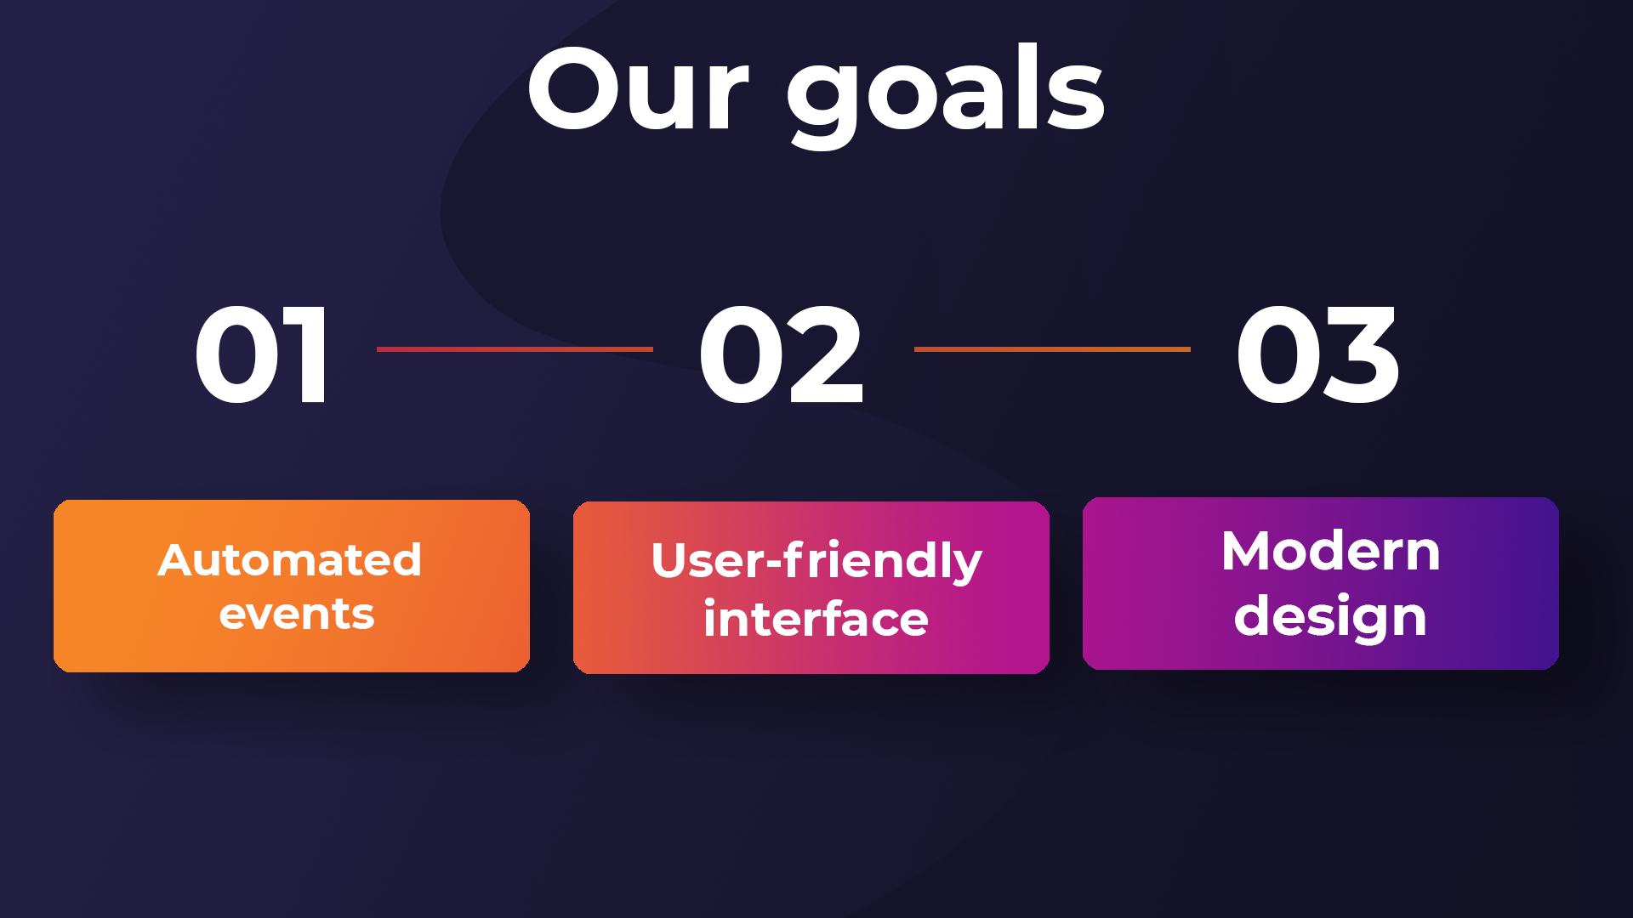
Our goal
Through all the time we were in close relations with the MVR and the Burgas Fire Department. We took close care to make it automated and easy to work with.

Slide 4
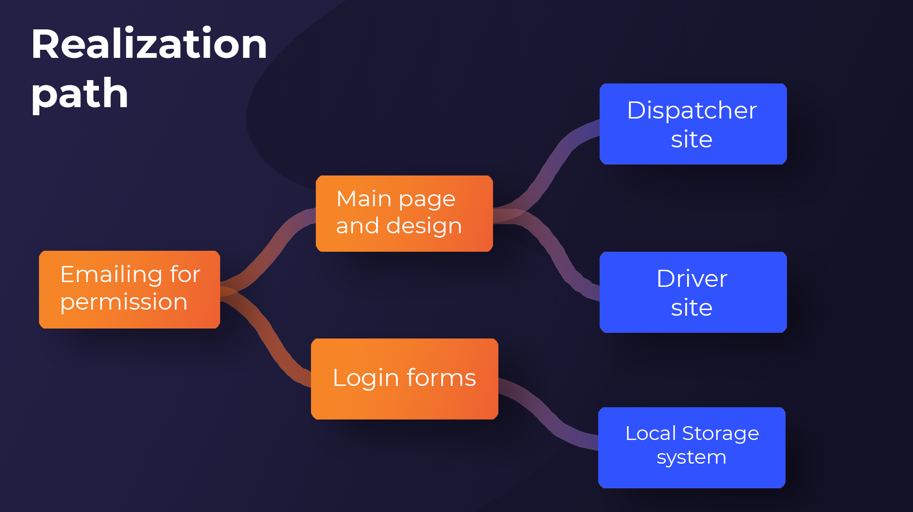
Realization path
We wrote an Email to the Burgas Fire Station to get all the information required to start our project. Then we Started organizing our tasks.
The first thing we did was the main page and the design sketches. Then we started with our login and report forms
After we were done with the main page, we started doing the dispatcher and driver sites. The data storage we are using is “localstorage” and we had a great time doing the main logic behind it.

Slide 5















Slide 6

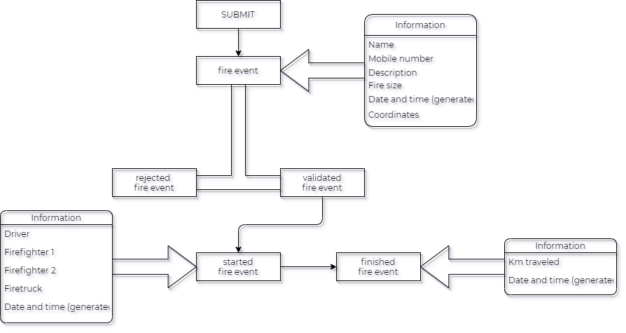

Slide 7

Questions

